Slide 1
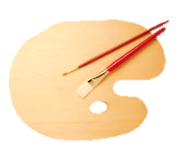
Leonardo da Vinci
1452 - 1519

Slide 2
Naumova darya selyutina yulia gumarova albina
Presented by

Slide 3
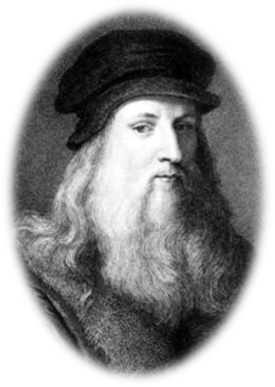
Biography
The illegitimate son of a 25-year-old notary, Ser Piero, and a peasant girl, Caterina, Leonardo was born on April 15, 1452, in Vinci, Italy, just outside Florence. His father took custody of the little fellow shortly after his birth, while his mother married someone else and moved to a neighboring town.

Slide 4
Childhood
Growing up in his father's home, Leonardo had access to scholarly texts owned by family and friends. Even as an apprentice, Leonardo demonstrated his colossal talent.
His handwriting is amazing, he wrote from right to left, the letters are reversed so that the text easier to read using a mirror
In an era when left-handedness was considered the devil's work and lefties were often forced to use their right hand, Leonardo was an unrepentant southpaw. It has been suggested that this "difference" was an element of his genius. He even wrote backwards, and his writings are easily deciphered only with a mirror.

Slide 5
Professional activities
Leonardo da Vinci was not only a great artist, painter, sculptor and architect, but also a brilliant scientist, to study mathematics, mechanics, physics, astronomy, geology, botany, anatomy and physiology of humans and animals,
In his manuscripts there are drawings of flying machines, parachutes and helicopters, new designs and machine tools, printing, woodworking and other machines.

Slide 6
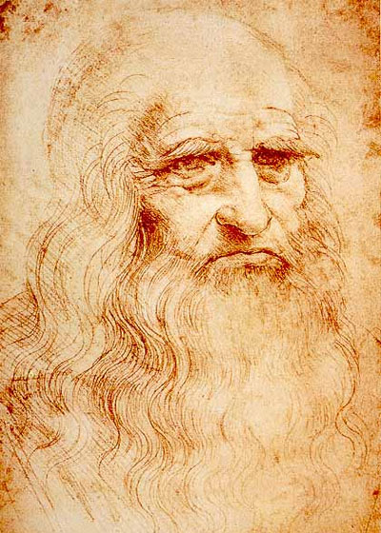
Leonardo da Vinci
Artist
Scientist
Inventor

Slide 7
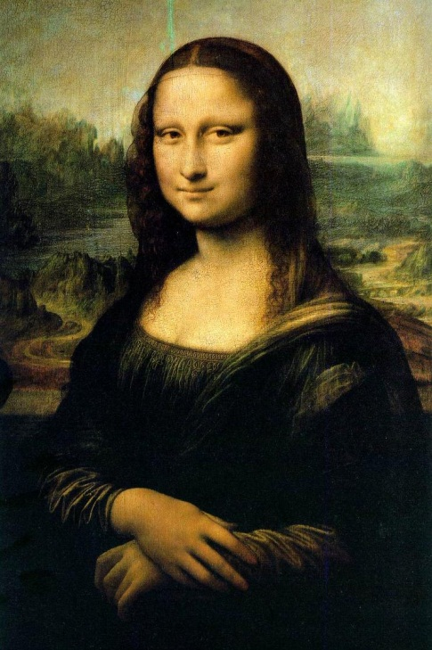
artist
Mona Lisa is a portrait painted in oil on a poplar panel by Leonardo da Vinci during the Renaissance in Florence, Italy. The work is currently owned by the Government of France and is on display at the Musée du Louvre in Paris.

Slide 8
He was the first artist to study the physical proportions of men, women and children and to use these studies to determine the "ideal" human figure.
All in all, Leonardo believed that the artist must know not just the rules of perspective, but all the laws of nature. The eye, he believed, was the perfect instrument for learning these laws, and the artist the perfect person to illustrate them

Slide 9
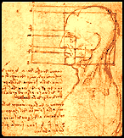
Scientist
Faculty of Medicine, he has learned to open the corpses of people for the study of reflexes.
He founded a new method of scientific research.

Slide 10
Inventor
Leonardo studied all forms of water - liquid, steam, and ice - and he had all sorts of swell ideas of what to do with it.
He cooked up plans for a device to measure humidity, a steam-powered cannon, many different waterwheels, and useful industrial machines powered by flowing water.

Slide 11
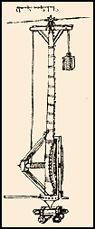
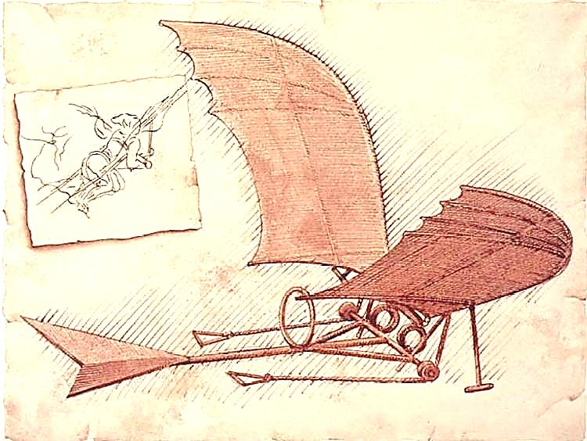
Inventor
He designed numerous weapons, including missiles, grenades, mortars, and even a modern-style tank.
Gears were at the heart of nearly all his inventions, from the crane to the helicopter to the automatic turnspit.

Slide 12
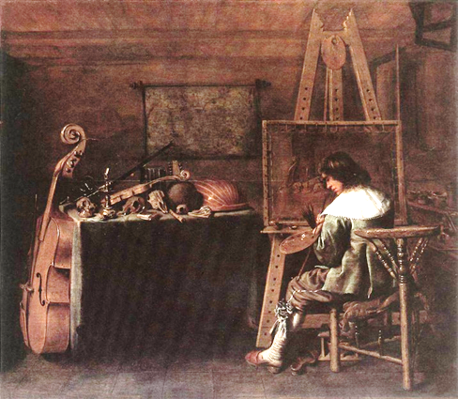
the end

